Slide 1

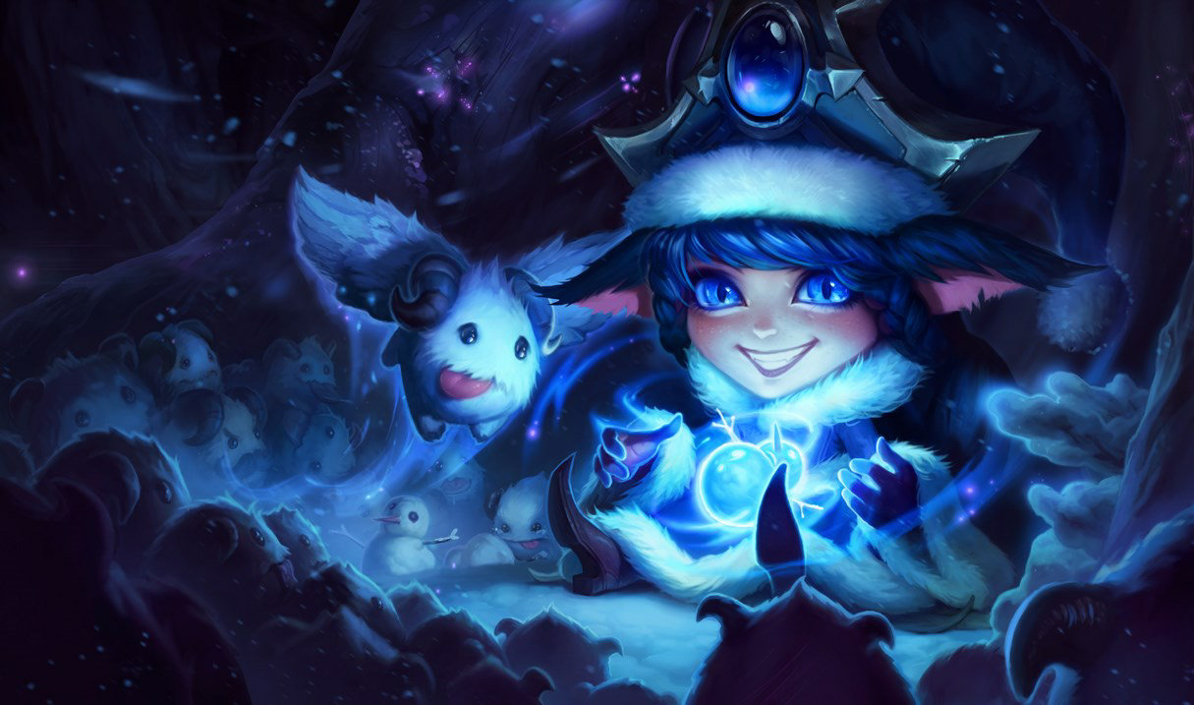
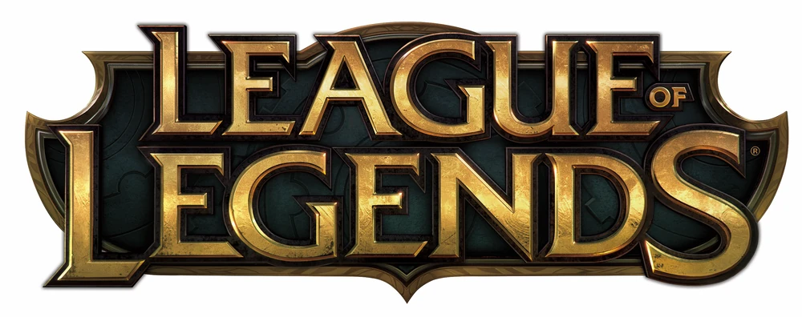
CS 677 Class Final Project
Professor: Eugene Pinsky
Name: Yidan Sun

Slide 2
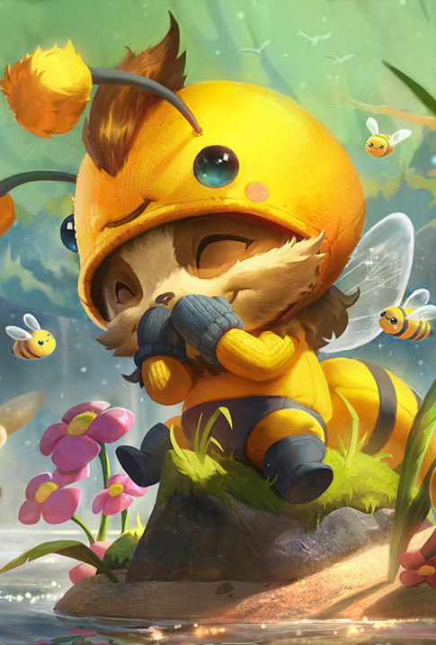
Contents
Part 1 LOL Introduction
Part 2 Raw Data & Variables
Part 3 Data Insights
Part 4 Classifiers & Strategies

Slide 3
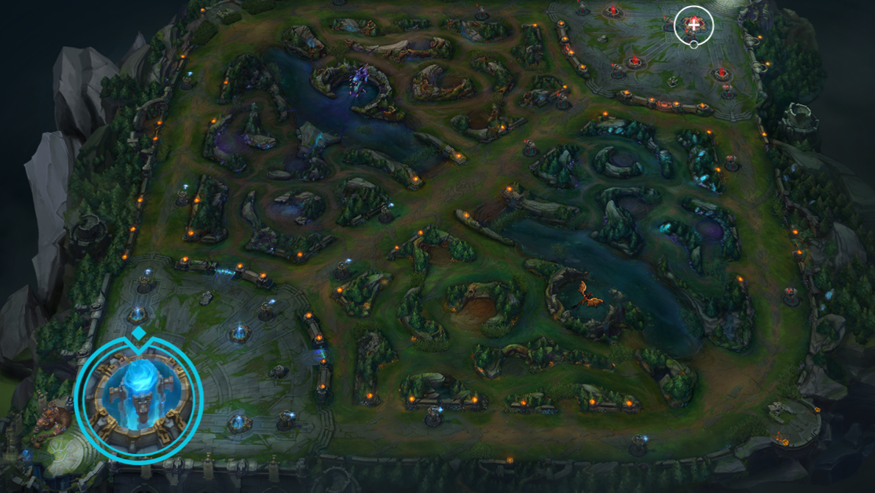
Part 1 LOL Introduction

Slide 4
Top Lane
Red Team
Nexus
Dragon
Middle Lane
Top Lane
Bottom Lane
Middle Lane
Dragon
Blue Team
Nexus
Bottom Lane

Slide 5
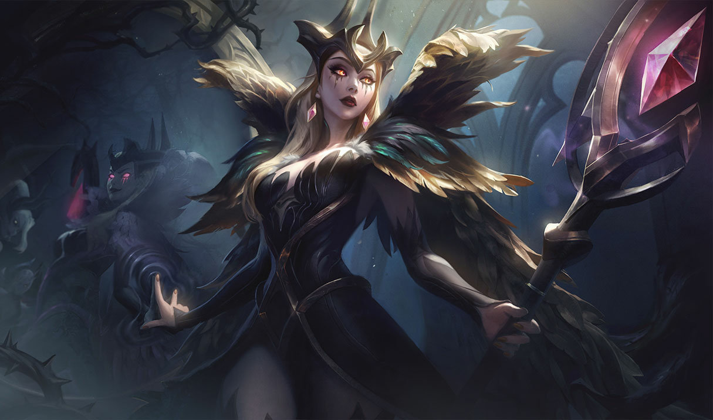
#Game rule
Red Team v.s.
Blue Team
#Factors toward win
if Enemy_Nexus down:
win ☺
else:
lose ☹
#Dragon/Herald
#Champions killed
#Towers down(Turret, Inhibitors)
#Minions killed
#Gold
……
#Players:
5 v.s. 5
Top(1),Mid(1),Bot(2),Jungle(1)

Slide 6
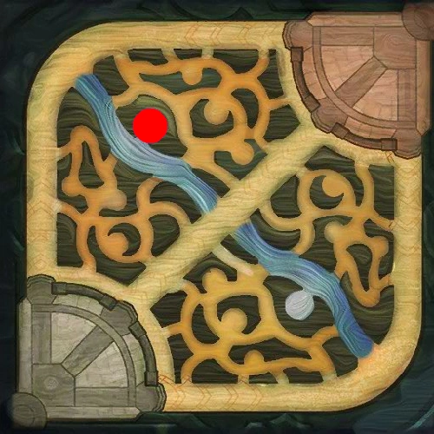
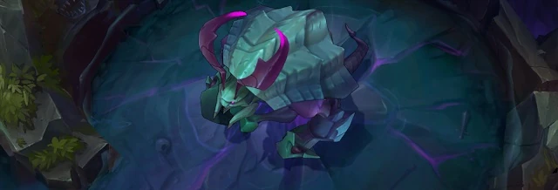
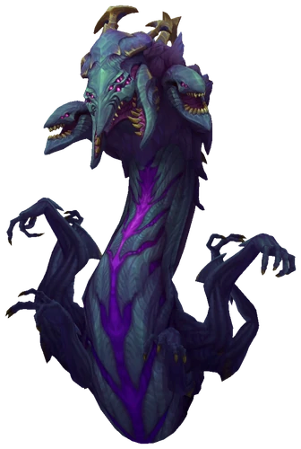
Monsters
The Rift Herald (Herald)
A powerful neutral Monster icon monster in Summoner's Rift icon Summoner's Rift. Same place as Baron Nashor.
Bonus effect: Faster recall channeling, Summon herald to push line.
Baron Nashor (Dragon)
Most powerful neutral Monster icon monster in Summoner's Rift icon Summoner's Rift. Same place as Baron Nashor.
Bonus effect: Bonus Attack Damage, Ability Power, Empowered Recall, Greatly increased power of minions

Slide 7
Part 2 Raw Data & Variables

Slide 8
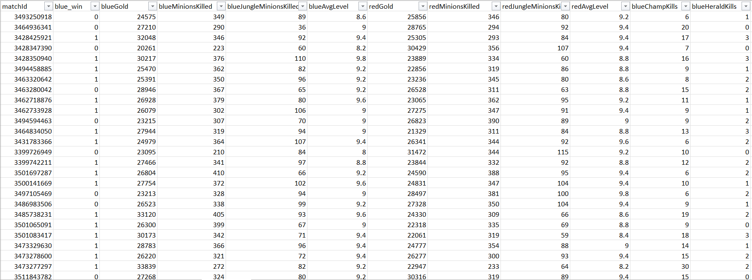
All about data
Game: League of Legend (LOL)
Data Context: First 15 mins Diamond (High Ranked) Match data
Data Source: Kaggle (Scraped from Riot API)
Data Total: 50000
Data Format: .csv
Features Type: Numerical Data
Data Label: Binary (Win/Loss)
Notes:
Data

Slide 9
Data Variables
Measure each team(red/blue) data
Match Id
Win/Loss
Gold
Minions Killed
Jungle Minions Killed
Average Level
Champ Kills
Herald Kills
Dragon Kills
Towers Destroyed

Slide 10
Part 3 data insights

Slide 11
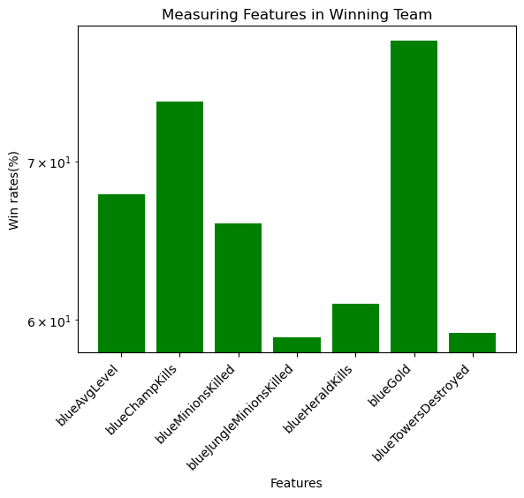
Overview data
In Winning Team:
78.71% has higher Gold
74.19% has higher Champion Kills
67.81% has higher Average Level
60.94% has higher # of Herald
59.26% has less Tower Destroyed
58.97% has higher Jungle minions killed
…..

Slide 12
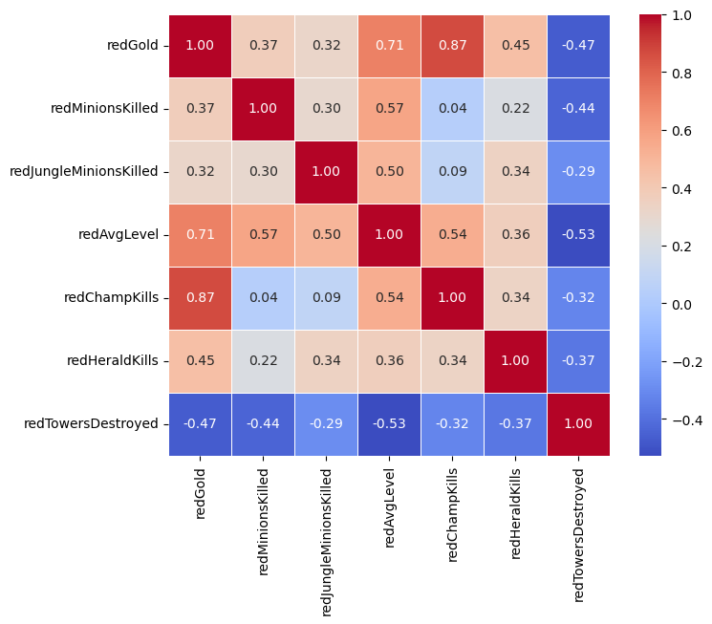
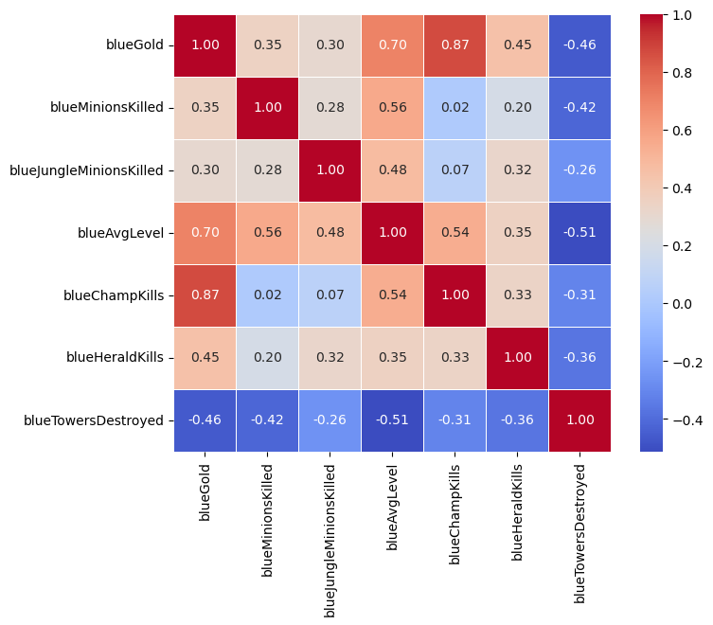
Potential correlation
Red team
blue team

Slide 13
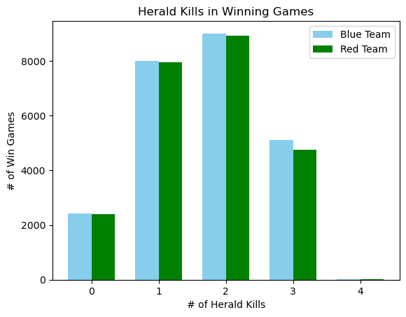
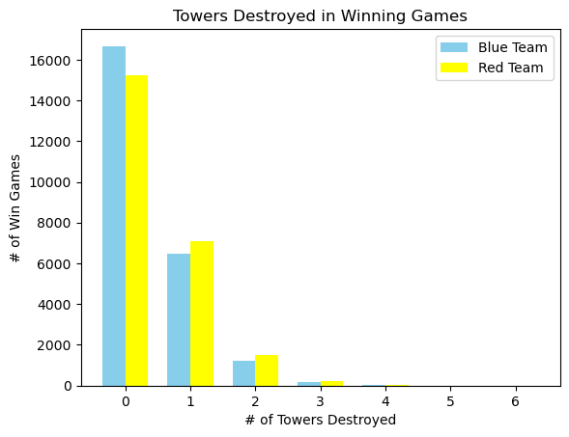
Some data insights
Little difference in win rate in either red team (49.46%) or blue team (50.54%)
Both Blue and Red Team wins when most Herald Kills=1,2
Champion kills and Average Levels is positively correlated with Gold
In most winning game, team has <=1 towers being destroyed

Slide 14
Part 4 Classifiers & STrategy

Slide 15
Chosen Classifiers(6)
Classifiers | TPR | TNR | ACC
KNN=4 | 99.97% | 2.17% | 51.90%
Logistic | 100% | 0% | 50.85%
LDA | 76.35% | 75.50% | 75.94%
QDA | 0 | 49.15% | 49.15%
Decision Tree | 67.61% | 67.50% | 67.49%
Naïve Bayes | 77.93% | 73.80% | 75.90%
Random Forest | 72.74% | 73.89% | 73.30%
KNN=4 performs Badly in Accuracy but has higher TPR
From Naïve Bayes Classifier accuracy, we can know that each variable is relatively independent, so that it could predict well.
LDA has similar TPR and TNR

Slide 16
Knn=4
Logistics
Most weighted features:
blueChampKills','blueHeraldKills','blueTowersDestroyed’
The optimal KNN is 4
Most weighted features:
'blueChampKills','blueHeraldKills',’
blueTowersDestroyed‘,'blueGold','blueMinionsKilled’,'blueJungleMinionsKilled', 'blueAvgLevel',
Use 50/50 split. No Obvious Difference between splitting the train set/ test set data.
50/50 split. Same as KNN
Accuracy: 51.90%
Accuracy: 50.85%
TPR:100%
TPR:99.97%
Extremely Abnormal.
All predictions are wins
Extremely abnormal
TNR:2.17%
TNR:0%

Slide 17
LDA
Naïve bayes
Insights:
Perform badly in QDA(high dimension), probably highly overfitting where all wins are predicted wrong
Insights:
Variables are relatively independent
Use 50/50 split. No Obvious Difference between splitting the train set/ test set data.
Use 50/50 split. No Obvious Difference between splitting the train set/ test set data.
Accuracy: 75.94%
Accuracy: 75.90%
TPR: 76.35%
TPR: 77.93%
Perform stable in TPR and RNR
Perform stable in TPR and RNR
TNR: 75.5%
TNR: 73.80%

Slide 18
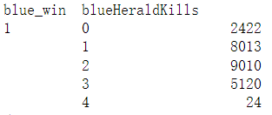
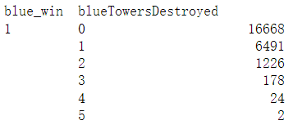
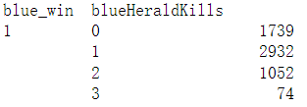
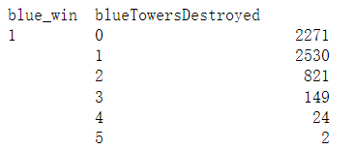
Failed attemps(4)
#blue_Herald<=2, blue has higher probability of win
True
DATA
LDA predicts wrong
#blueTowerDestroyed >=1 blue more possible to win.
Strategy I (26.89%)
Based on LDA, if blueTowersDestroyed <1 and | blueHeraldKills>=2 →→→win
Strategy II (36.66%)
Based on LDA, if blueTowersDestroyed =0 and | blueHeraldKills=2 →→→win

Slide 19
Optimal strategy
Strategy III(Optimal)
Strategy IV (last attempt)
Based on LDA and consider winning team features [ChampKills] [Gold]
Based on Strategy III and KNN
Accuracy: 77.94%
Accuracy: 51.59%
TPR: 78.95%
TNR: 76.91%
TPR:99.96%
TNR:2.17%

Slide 20
summary
Strategy 0: Combining LDA & NB (If they are same pick it, otherwise random pick)
Strategy I: Based on [Towers Destroyed] [Herald Kills] value
Strategy II: Based on [Towers Destroyed] [Herald Kills] [Champion Killed] value
Strategy III: Based on LDA Predict, and consider [ChampKills] [Gold]
Strategy IV: KNN +Strategy III (If Knn predicts ‘win’,then win, other wise S-III)
Category | LDA* | Strategy 0 | Strategy I | Strategy II | Strategy III | Strategy IV
Accuracy | 75.94% | 49.47% | 26.89% | 36.66% | 77.94% | 51.59%
TPR | 76.35% | 2.43% | 25.78% | 24.85% | 78.95% | 99.96%
TNR | 75.50% | 97.54% | 27.96% | 48.73% | 76.91% | 2.17%

